Slide 1


Classification-of-Depression-on-Social-Media-Using-Text-Mining
Supervised By: Prof. Sangeeta Sabharwal
DIVYANSH SAGAR 2020UCM2343
FARIS REHAMAN 2020UCM2341
ADITYA BABU 2020UCM2318
Notes:
https://unsplash.com/photos/AXu2aZ3YgP8

Slide 2

INTRODUCTION

Slide 3

INTRODUCTION
Summary:
1. Mental illness, particularly depression, is a prevalent global issue, prompting a desire to provide assistance and support.
2. The study aims to explore this issue by utilizing a substantial amount of data collected from tweets and Facebook posts.
3. Machine learning techniques will be employed to extract valuable insights from this data, offering meaningful and practical outcomes.
4. Social media platforms generate vast amounts of data daily due to the active participation of millions of users, transforming the way people interact with each other.
Notes:
https://unsplash.com/photos/fItRJ7AHak8

Slide 4
MOTIVATION
Our motivation is fueled by a deep-seated compassion for those
who suffer in silence, and our goal is to transform this data into
actionable resources that can provide support, understanding, and
hope.While Social media provides a platform for individuals to express
their thoughts and feelings, it can also be a source of distress and
negative influence
Notes:
https://unsplash.com/photos/fItRJ7AHak8

Slide 5
PROBLEM STATEMENT
The aim of the project is to predict early signs of depression
through Social Media text mining. By harnessing the immense
wealth of data from tweets , we are using the power of
machine learning to extract meaningful insights
By identifying individuals at risk and providing them with
information, resources, and even connections to mental health
professionals, we hope to create a more accessible and
supportive environment for individuals dealing with depression
Notes:
https://unsplash.com/photos/fItRJ7AHak8

Slide 6
SOME
STATISTICS

Slide 7


STATISTICS
s
58% of Americans say social media negatively affects their mental health
Among those affected, 64% experience anxiety from social media use
Users also experience depression (56%), dissatisfaction with life (52%), fear of missing out (52%), and body image issues (51%) as a result of these apps
Facebook, Instagram, and TikTok top list of social media platforms that are most harmful to mental health.
Notes:
https://unsplash.com/photos/TvN54bnuQg8

Slide 8
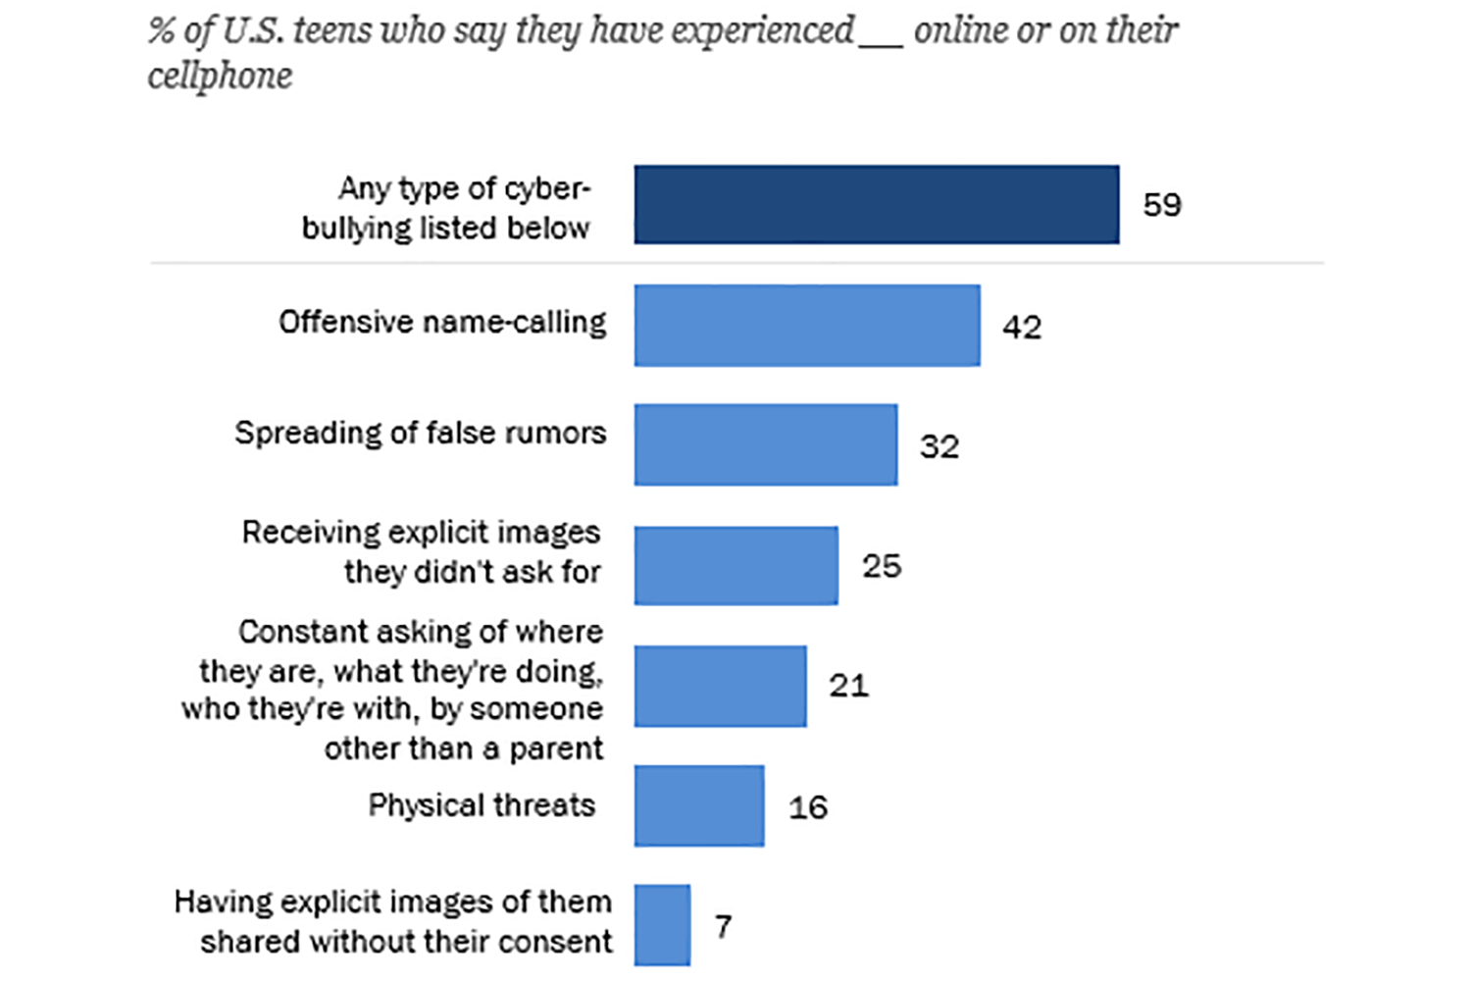
1
Notes:
https://unsplash.com/photos/TvN54bnuQg8

Slide 9

OBJECTIVE

Slide 10

OBJECTIVE
The aim of the project is to predict early signs of depression through Social Media text mining. Below are the steps to run the python codes using the data sets.
Notes:
https://unsplash.com/photos/48nerZQCHgo

Slide 11
Methodology and Work-flow

Slide 12
METHODOLOGY
1. Create a twitter developers account, From that account your would need 4 things.
consumer_key = '', consumer_secret = '', access_token = '', access_secret = ''
2. Using the file "Download_twitter_Api.py" insert the credentials and you can download current tweets using keywords such us depression, anxiety or sadness. When data sets are ready you may proceed on the preprocessing stage.
3.Run "preprocessor.py", This stage will go through your data sets and the given dictionary. The dictionary contain words with their corresponding polarity, which is essential to calcualting the sentiment of each tweet, each word will be seperated, tokenized and given its polarity. Every tweet will consist of the summation of all polarity of each word and devided by number of words in that tweet.
Notes:
https://unsplash.com/photos/48nerZQCHgo

Slide 13
4. Once preprocess is done. You can find the file in the directory "processed_data/output.xlsx". Opening it you will find that the ID (tweet) and Sentiment of each tweet is separated into 2 columns. With this output you now have a twitter data set and its corresponding sentiment filtered by depress keywords. (Positive, Neutral and Negative).
5. Now for training and Predicting. Make sure all files are located in proper folders, Run "depression_sentiment_analysis.py". The code will run through the output.xlsx file and at the same time recover the tweet corresponding to the id of each sentiment. using this we use the original data and feed them to our classifiers. When everything is done you should have all the AUC of each classifier listed in the console.
.
Notes:
https://unsplash.com/photos/48nerZQCHgo

Slide 14
6. But wait, There's more. You will also have the ability to type in a sample tweet, The tweet will go through the highest AUC in the list of classifier to predict the sentiment of the tweet you wrote.
.
Notes:
https://unsplash.com/photos/48nerZQCHgo

Slide 15
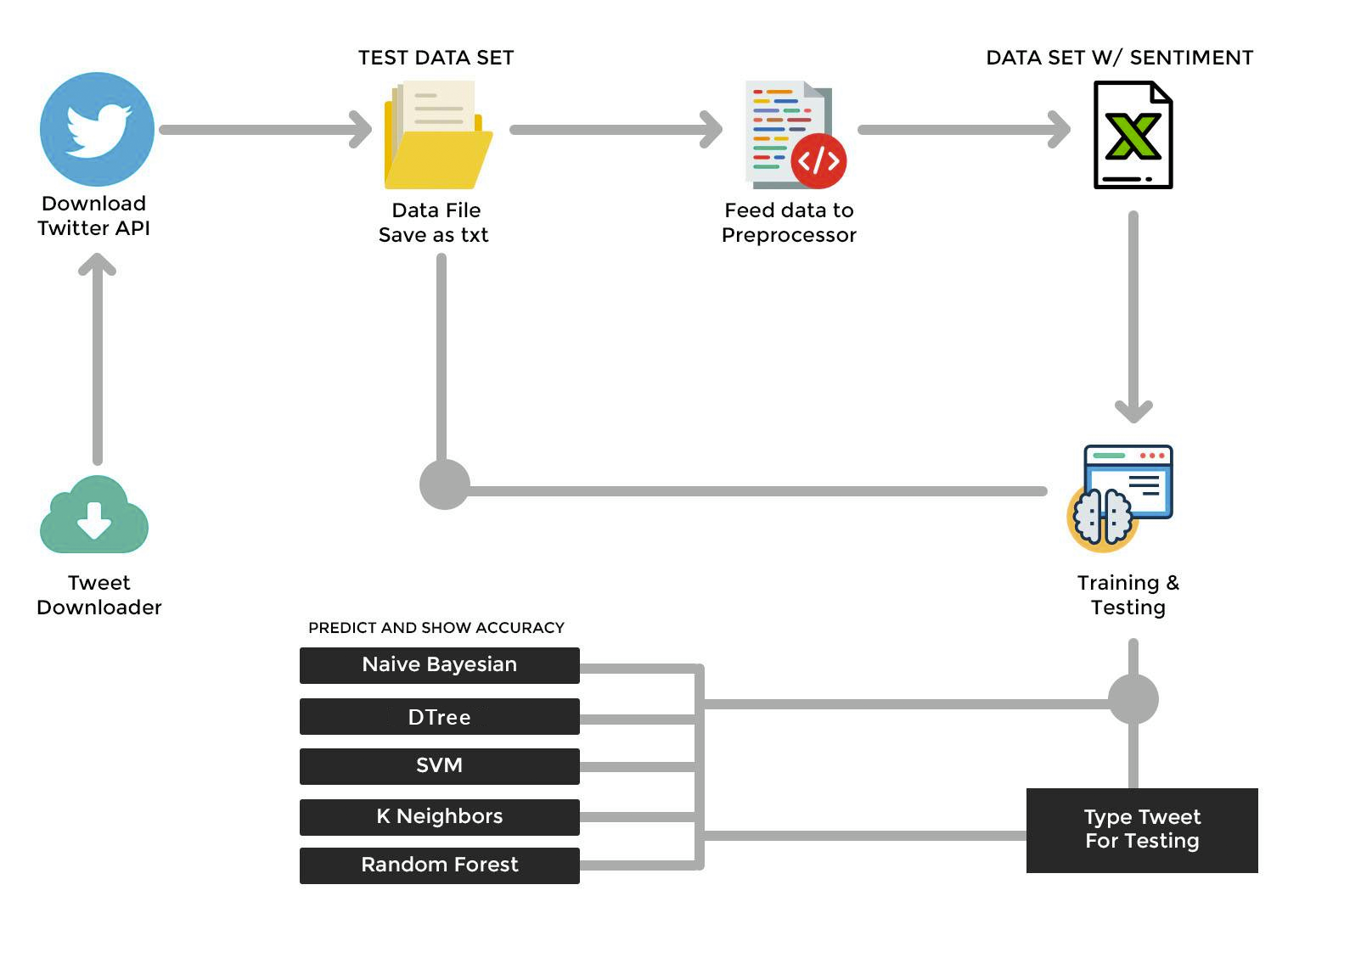
Notes:
https://unsplash.com/photos/48nerZQCHgo

Slide 16
Overall tools and technologies used

Slide 17
TOOLS AND TECH USED
Python 3.6.1 or Higher:
Python, a high-level programming language, was used as the primary coding language for this project. The specified version or higher was required for compatibility with various libraries and modules.
Twitter Developer Account:
A Twitter Developer Account was utilized to access the Twitter API. This account provided essential credentials such as consumer key, consumer secret, access token, and access secret, enabling the retrieval of tweets related to depression.
.
Notes:
https://unsplash.com/photos/48nerZQCHgo

Slide 18
Modules and Libraries:
Keras:
Open-source high-level neural networks API simplifying artificial neural network development. Crucial for the project's machine learning aspects.
TensorFlow (TF):
Open-source machine learning library by Google Brain, serving as the core for implementing and training machine learning models in the project.
NumPy:
Powerful library for numerical operations, facilitating efficient handling and manipulation of large, multi-dimensional arrays and matrices in the project.
Pandas:
Data manipulation and analysis library offering structures for efficient handling of large datasets. Played a crucial role in preprocessing and organizing the dataset.
itertools:
Python Standard Library module providing tools for fast, memory-efficient iteration. Likely used for efficient looping within the project.
Notes:
https://unsplash.com/photos/48nerZQCHgo

Slide 19
LIBRARIES/DEPENDENCIES USED
Naive Bayes
Probabilistic algorithm based on Bayes' theorem, ideal for classifying sentiments in social media posts.
Decision Tree:
Tree-like model making decisions based on simple rules, effectively classifying tweets to identify depression-related content.
Support Vector Machine (SVM):
Powerful model finding optimal hyperplanes, utilized to separate social media data into sentiment classes, aiding depression prediction.
K-nearest Neighbors (Neighbors):
Simple instance-based learning algorithm classifying tweets based on their k-nearest neighbors, revealing patterns in depression-related content.
Random Forest:
Ensemble method constructing multiple decision trees, enhancing accuracy in predicting sentiments associated with depression in tweets
Notes:
https://unsplash.com/photos/48nerZQCHgo

Slide 20
SOME SAMPLE TWEETS ANALYSIS

Slide 21
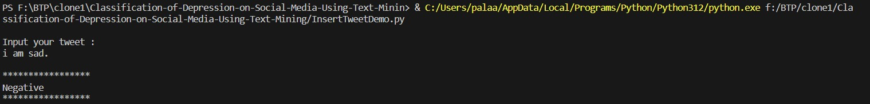
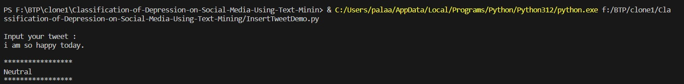
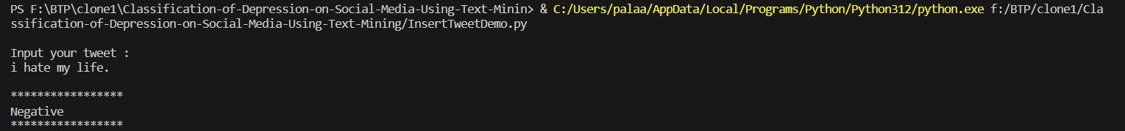
Notes:
https://unsplash.com/photos/48nerZQCHgo

Slide 22
Performance of Different Models

Slide 23
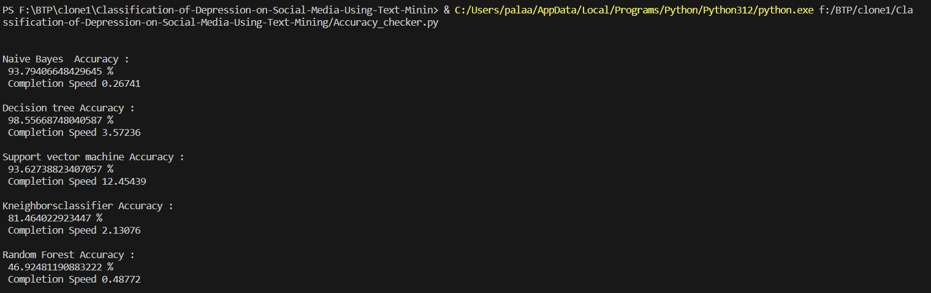
.
Notes:
https://unsplash.com/photos/48nerZQCHgo

Slide 24

OUTCOME OF
PROJECT

Slide 25

OUTCOME OF
PROJECT
Summary in Points:
1. Positive Result: Indicates the person is unlikely to have depression or anxiety.
2. Neutral Result: Suggests a middle ground where the user may or may not have depression, showing some depression-like symptoms.
3. Negative Result: Indicates the lowest level, where depression and anxiety symptoms are detected in the user's tweets.
4. Negativity Level: The number of negative words used in the tweets correlates with the intensity of negative emotions expressed.
Notes:
https://unsplash.com/photos/GKLIsLZxhj0

Slide 26
CHALLENGES AND CONCERNS

Slide 27
CHALLENGES AND CONCERNS
1. User Consent: Obtaining user consent for data usage.
2.Regulatory Compliance: Complying with data privacy regulations.
3. Data Privacy: Protecting user privacy in data collection.
4. Data Bias: Potential bias in social media data.
5. Inaccurate Reporting: Users may not truthfully represent their mental state.
6. Use of stopwords to increase accuracy of model.
Notes:
https://unsplash.com/photos/TvN54bnuQg8

Slide 28
LITERATURE SURVEY
A literature survey on the classification of depression using text mining involves exploring research papers and studies related to the application of text mining and natural language processing (NLP) techniques
"Natural Language Processing in Mental Health Applications Using Social Media" (2019)
"Text Mining for the Analysis of Depression: A Review" (2014) by Al-Maskari et al.
"Mining Twitter Data for Suicide Prevention" (2018) by Burnap et al.
"Depression Detection from Social Media: A Comparative Study" (2019) by Xue et al.
Notes:
https://unsplash.com/photos/48nerZQCHgo

Slide 29
SCOPE FOR FUTURE WORK
Use Contextual Semantic segmentation
Use Stopwords to increase accuracy of model
Eliminating features with extremely low frequency
Use Complex Features: n-grams and part of speech tags
Notes:
https://unsplash.com/photos/TvN54bnuQg8

